Slide 1
Think Small To Go Big – An Introduction To Microservices
By: Ryan Baxter
@ryanjbaxter http://ryanjbaxter.com
3/11/15

Slide 2

We Have A Need For Speed

Slide 3

Agile Meant Speed

Slide 4
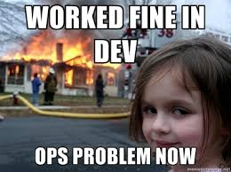
….but we couldn’t deploy fast enough

Slide 5
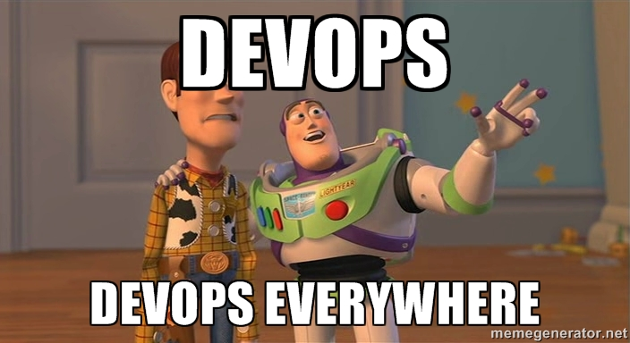
Now We Have DevOps

Slide 6
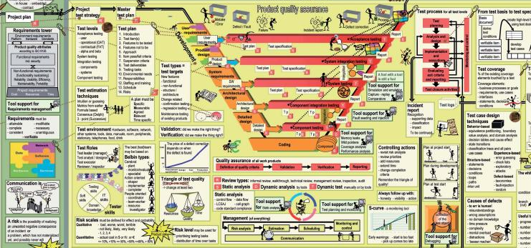
….but getting infrastructure takes too long

Slide 7

The Cloud Made Infrastructure Easy

Slide 8

…but our apps were not built for the cloud

Slide 9
New Challenges In Today’s World
As developers, we are facing new challenges
Speed
Flexibility
Multiple platforms
Unprecedented scalability
Infrastructure that is out of our control

Slide 10

Infrastructure That Is Out Of Our Control

Slide 11

Unprecedented Scale

Slide 12



How Did We Solve This Problem Before?

Slide 13
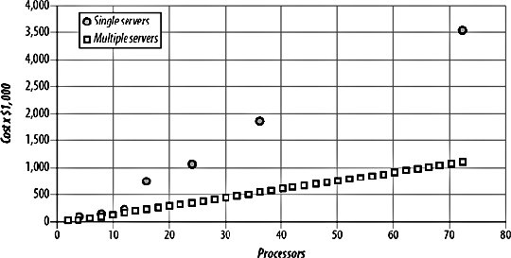
Scaling Horizontally Is Cheaper

Slide 14
We End Up With Something Like This
Load Balancer

Slide 15

Different Platforms

Slide 16

Requires A New Way Of Thinking
Our old application designs just can’t keep up
Massive monolithic applications break down under these new challenges

Slide 17

We Need A New Architecture
Applications that are composed of smaller more focused “micro” apps

Slide 18
What is a Microservice?
“In short, the microservice architectural style is an approach to developing a single application as a suite of small services, each running in its own process and communicating with lightweight mechanisms, often an HTTP resource API.” - Martin Fowler

Slide 19
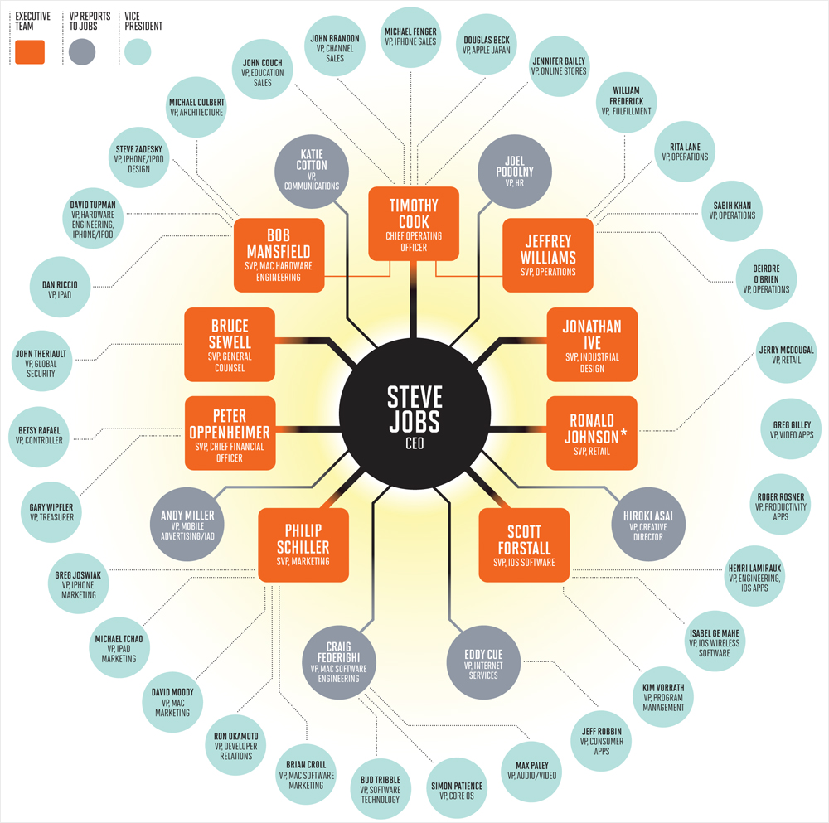
It’s Not All About The Code

Slide 20
Guidelines For Microservices
Make each one focused – no real rule on size
“2 pizza teams”
Each service should be treated like one app
Have its one SCM repo, own pipeline, etc
Should not require the use of other services
Service owners are responsible for the entire lifecycle
Use lightweight protocols
Use the right tool for the job

Slide 21
Guidelines For Microservices
Each service should have its own datastore
Failure will happen, design for it
Automate everything

Slide 22
Isn’t This Just SOA?
Hot topic, they are certainly very similar and try to solve the same problem
SOA was always considered very heavy
ESBs
Driven by vendors
SOA allowed for monoliths
SOA was more about reuse than team organization and application architecture

Slide 23
Benefits Of Microservices
Code for each service is easier to understand
Small code base means more speed
Each service can be deployed independently
Failures do not bring down the whole app
Technology flexibility
Easier to evolve
Well defined APIs

Slide 24
Cons Of Microservices
Complexity
You have to manage multiple apps
Deploying 1 feature may involve coordination between multiple services
Performance – multiple service calls
When to switch to microservices
Dev tools focus on monolithic apps
Duplication of code
End To End Testing

Slide 25
DEMO

Slide 26



Monolith Architecture
App
Client Side Code
Sessions APIs
DB
Questions APIs
Twilio Endpoint
SMS/Email Service

Slide 27
Failures In A Monolith
App
Client Side Code
Sessions APIs
DB
Questions APIs
Twilio Endpoint
SMS/Email Service

Slide 28
Scaled Monolith
App
My App 1
Client Side Code
Sessions API
Questions API
Twilio Endpoint
DB
SMS/Email Service
Load Balancer
My App 1
App
Client Side Code
Sessions API
Questions API
Twilio Endpoint
SMS/Email Service

Slide 29
Microservices Architecture
Sessions DB
Client Side Code
Sessions Service
Questions DB
Questions Service
Reply Service
MessageQueue
SendGrid Service
Twilio Service

Slide 30
Client Fragility
Sessions DB
Client Side Code
Sessions Service
Questions DB
Questions Service
Reply Service
MessageQueue
SendGrid Service
Twilio Service

Slide 31
API Gateways
Sessions DB
API Gateway
Sessions Service
Questions DB
Questions Service
Client Side Code
Reply Service
MessageQueue
SendGrid Service
Twilio Service

Slide 32
Scaling A Service
Sessions DB
Sessions Service
API Gateway
Sessions Service
Questions DB
Questions Service
Client Side Code
Reply Service
MessageQueue
SendGrid Service
Twilio Service

Slide 33
APIs
Services communicate with each other and clients via a well established API
REST + JSON is a very common choice
Message queues can be used for asynchronous support
Use an API gateway!

Slide 34
Service Discovery
Questions DB
Sessions Service
Sessions DB
Questions Service
Sessions Service
Service Discovery
API Gateway
Twilio Service
Client Side Code
MessageQueue
Reply Service
SendGrid Service

Slide 35
Service Discovery
Eureka – Neflix OSS Component
Zookeeper – Apache Project
Consul

Slide 36

Circuit Breakers

Slide 37
DEMO

Slide 38
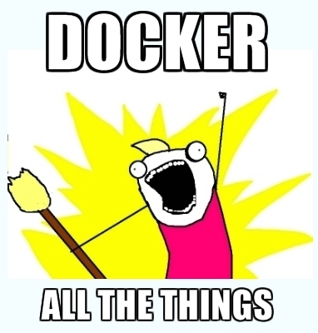
Containers/Docker
Is a great deployment and isolation tool for your microservices
Allows your microservices to run on various clouds
Need to use some kind of container management tool to orchestrate, monitor, and scale your microservices

Slide 39

Platform-as-a-Service
Deploying a large scale distributed set of apps requires a lot of effort (even if you are using Docker)
A platform-as-a-service can make it somewhat easier
Built in monitoring, recovery, and scaling can really go a long way
Deployments are also much easier because you just provide the code
Take a look at any Cloud Foundry based PaaS

Slide 40
Deploying Microservices With Cloud Foundry
Easy as cf push appname –p <jar file>
Or use Cloud Foundry Maven or Gradle plugin
You can use blue/green deployments to make sure you have no downtime during deploys
Each microservice can be used as a Cloud Foundry service to facilitate service discovery
Built-in load balancer can help with dynamic scaling
Everything can be automated so it all happens on commit

Slide 41

Netflix
The poster child for microservices
They have a great set of open source libraries in the Neflix OSS project
Service Discovery, Circuit Breakers, Service To Service Communication, and much much more…
Check out Spring Cloud if you are a Spring user, very easy to integrate Netflix OSS into your apps

Slide 42
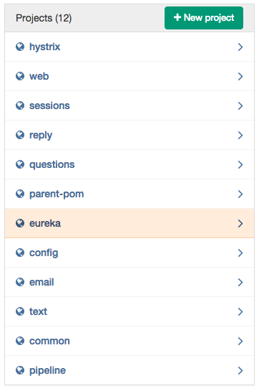
Microservices In SCM
Don’t think you can still put all your code in a single repo
Each service should have its own repo
Each one can then be branched and evolve without effecting others

Slide 43

Transitioning To Microservices

Slide 44
Deployment Pipelines
Commit code
Do build and unit tests
Deploy App
Test App
Use load balancer to direct users to new version of app
Kill old version of app

Slide 45
Thank you.

